Slide 1
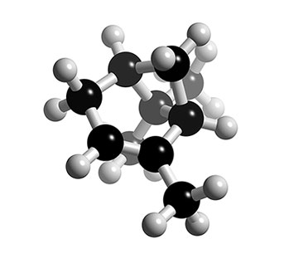


Modeling Secondary Organic Aerosol Formation during β-pinene Photo-oxidation and Ozonolysis
Karl Ceulemans – Steven Compernolle – Jean-François Müller
(karl.ceulemans@aeronomie.be)
Belgian Institute for Space Aeronomy, Brussels, Belgium
Atmospheric Chemical Mechanisms, Davis CA, 2012

Slide 2
Outline
β-pinene as biogenic source of SOA
BOREAM: Detailed model for biogenic SOA
Extension of BOREAM to β-pinene
Comparison against experiments:
  Gas phase chemistry
  SOA
Photochemical aging of β-pinene SOA

Slide 3
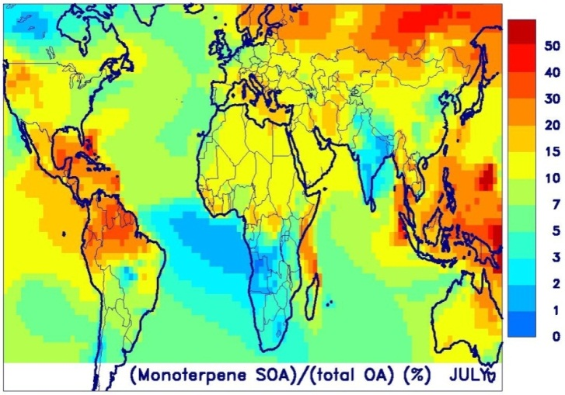
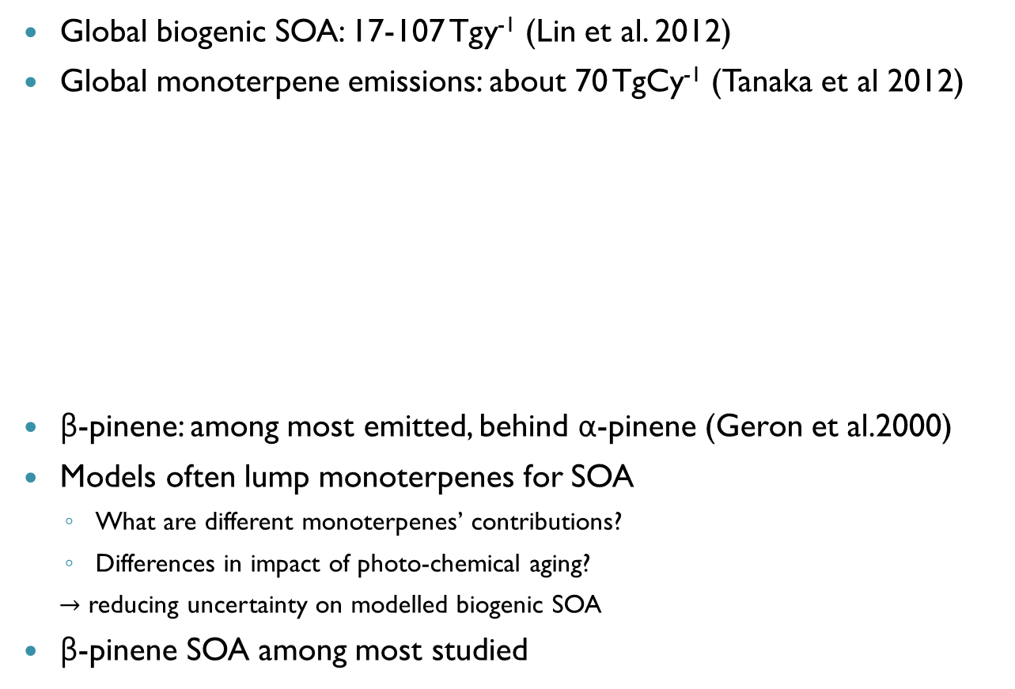
β-pinene: atmospheric relevance
Global biogenic SOA: 17-107 Tgy⁻¹ (Lin et al. 2012)
Global monoterpene emissions: about 70 TgCy⁻¹ (Tanaka et al 2012)
β-pinene: among most emitted, behind α-pinene (Geron et al.2000)
Models often lump monoterpenes for SOA
  What are different monoterpenes’ contributions?
  Differences in impact of photo-chemical aging?
  $→$ reducing uncertainty on modelled biogenic SOA
β-pinene SOA among most studied
Contribution of monoterpenes to SOA, estimated with CTM IMAGESv2
(preliminary result)

Slide 4
BOREAM
Biogenic hydrocarbon Oxidation and Related Aerosol formation Model
Previously focused on α-pinene
Gas phase reaction model based on theoretical calculations and SARs, additional generic chemistry and aerosol formation module
15000 reactions, 2500 species, using KPP (Sandu et al. 2002)
SOA yields predicted reasonable well for α-pinene smog chamber experiments (Ceulemans et al 2012)

Slide 5
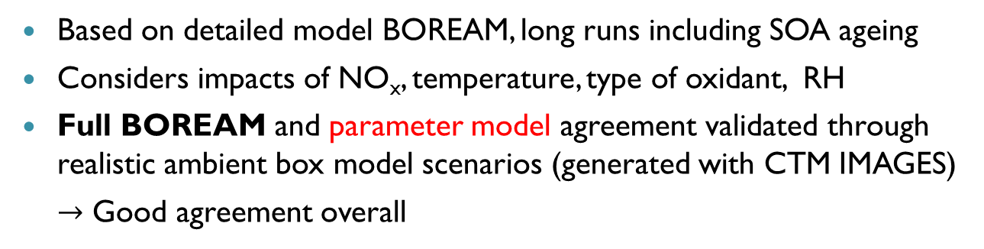
Parameterization for α-pinene SOA
Ceulemans et al. (2012), ACP
298 K
Based on detailed model BOREAM, long runs including SOA ageing
Considers impacts of NO_{x}, temperature, type of oxidant, RH
Full BOREAM and parameter model agreement validated through realistic ambient box model scenarios (generated with CTM IMAGES)
$→$ Good agreement overall

Slide 6
β-pinene: ozonolysis mechanism
Theoretical study of the gas-phase ozonolysis of β-pinene
T.L. Nguyen, J. Peeters, L. Vereecken
Phys. Chem. Chem. Phys., 2009,11,5643-5656
Nguyen et al. (2009)
Fig.6
2 primary ozonides
decomposition to
  CI-1+ CH₂O (48.8%)
  CI-2 + CH₂O (46.2%)
  nopinone + CH₂OO (5%)
CI-2:
  SCI-2 (20.6%)
  dioxirane
    lactones (17%), biradical(10%)
  biradical RAD-3 (2.0%)
CI-1:
  SCI-1 (16.2%)
  hydroperoxide channel (28.3%)

Slide 7
β-pinene ozonolysis mechanism: biradicals
Formation of biradicals:
  RAD-3 (3% yield, see Nguyen et al. 2009)
  Biradical from decomposition of dioxiranes(possibly10% yield)
detailed treatment of possible reactions included in BOREAM, based on SARs for peroxy/alkoxy/alkyl radicals
Remains speculative and needs further theoretical/experimental verification
Functionalized products

Slide 8
β-pinene ozonolysis mechanism: acid formation
Pinic acid formation:
  not theoretically explained yet
  Presumed to originate in hydroperoxide channel (for example: Jenkin, 2004)
  We include a yield fitted against the pinic acid yield of Yu et al. (1999), about 3.5% total yield from β-pinene

Slide 9
β-pinene: OH oxidation mechanism
A theoretical study of the OH-initiated gas-phase oxidation of β-pinene: first generation products, L. Vereecken & J. Peeters,
Phys. Chem. Chem. Phys., 2012,14,3802-3815
Major pathways
  OH-addition on C_{a} and C_{b} (83.3% and 6.8%)
  H-abstraction from C_{c} and C_{d} (5.9% and 3.%)
New chemistry for major OH-addition product
  A ring opening of alkyl radical BPINOH1*
  Peroxy-radical R1OO
    High-NO_{x} : reaction with NO followed by ring closure of alkoxy radical
    Low-NO_{x} : ring closure of peroxy radical

Slide 10
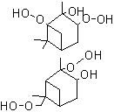

BOREAM: Generic chemistry
Semi-generic: carbon number and functional groups
Generic: carbon number, vapour pressure classes (11) and 1explicit functional group
Second generation oxidation products lumped into semi-generic and generic products
10 carbons
1 alcohol &
2 hydroperoxide
LA10HPP
LX9cONO2
Implicit parent structure, with p_{vap,im}

Slide 11
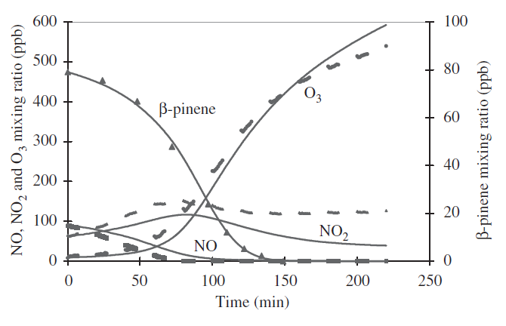
β-pinene: some previous modelling results
Chen & Griffin 2005:
  Shown is fig. 1,
  experimental and modeled
  β-pinene, O₃, NO, NO₂ from
  this paper
Jenkin (2004) for SOA
Pinho et al. 2007:
gas-phase, using MCM3.1:
Fig.9 showing D(O₃-NO)
in ppm for Carter (2000)

Slide 12
β-pinene gas phase chemistry: ozone
β-pinene oxidant
OH: 47.8%
O₃: 26.8%
O(3P): 20.9%
NO₃: 4.5%
BOREAM: overestimates ozone, adding O(3P) channel improves things
Less SCI-decomposition further improves, but more testing needed

Slide 13

β-pinene SOA: Photo-oxidation
Ng et al., 2006 (high NO_{x})
Saturated vapor pressure estimation methods:
EVAPORATION or
Capouet-Müller(2006) $→$
See poster by Steven Compernolle
BOREAM: reasonable agreement, overestimated up to 20% near end
Low-NO_{x} photo-oxidation: few experiments available for validation

Slide 14
β-pinene photo-oxidation: SOA composition (high-NO_{x})
Molar composition for Ng et al. (2006) after 2 hours:
BOREAM SOA is dominated by nitrates and peroxy acyl nitrates (PANS), some contribution of hydroperoxides
Auld & Hastie (2011): nitrates, some with mass 231 detected

Slide 15
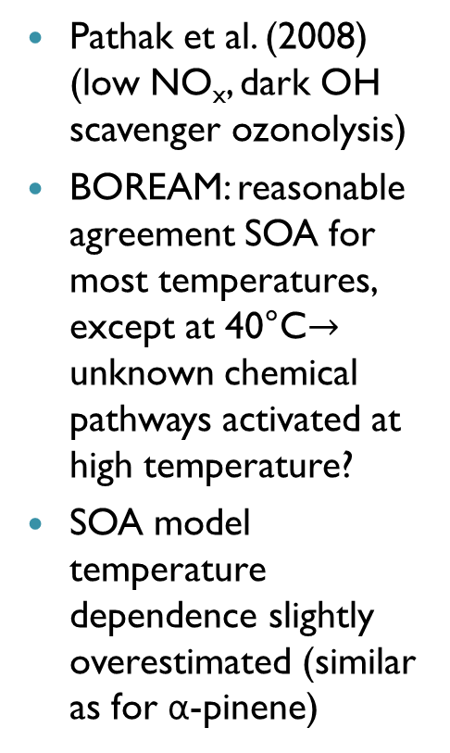
β-pinene SOA: ozonolysis
Pathak et al. (2008) (low NO_{x}, dark OH scavenger ozonolysis)
BOREAM: reasonable agreement SOA for most temperatures, except at 40°C$→$ unknown chemical pathways activated at high temperature?
SOA model temperature dependence slightly overestimated (similar as for α-pinene)

Slide 16
β-pinene ozonolysis: Sensitivity of SOA yield to chemistry
Biradicals: important for SOA, lead to many functionalized species
pinic acid important SOA contributor
Some SCI-oligomers formed through SCI + molecular products (few %), though they don’t increase SOA yields strongly in this case

Slide 17
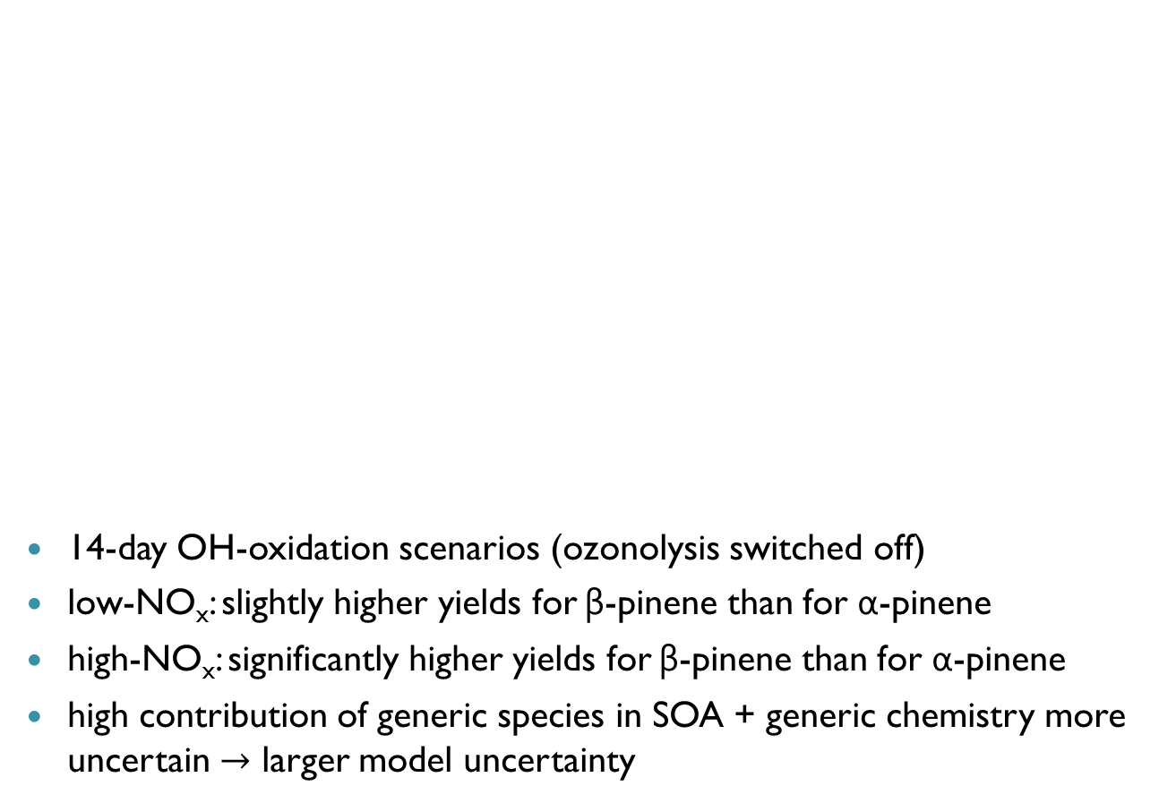
Photo-oxidative aging: comparison β-pinene vs. α-pinene
14-day OH-oxidation scenarios (ozonolysis switched off)
low-NO_{x}: slightly higher yields for β-pinene than for α-pinene
high-NO_{x}: significantly higher yields for β-pinene than for α-pinene
high contribution of generic species in SOA + generic chemistry more uncertain $→$ larger model uncertainty

Slide 18
Conclusions
BOREAM extended to β-pinene, based on recent theoretical mechanisms
Gas-phase chemistry: ozone formation too high at later stages: more validation needed
SOA:
  generally agrees reasonably for ozonolysis, except at high temperatures (40°C)
  agrees for some photo-oxidation experiment, more comparisons necessary (solar radiation,low-NO_{x})
First tests: photochemical aging through OH-oxidation leads to more SOA for β-pinene than for α-pinene

Slide 19
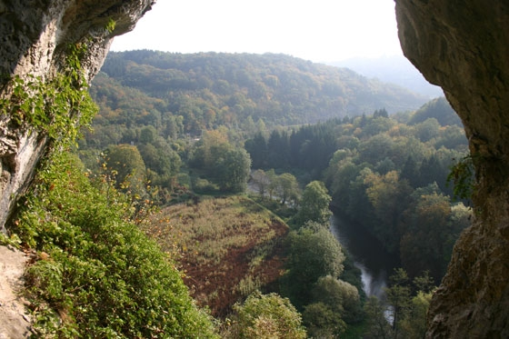
Thank you for your attention!

