Slide 1


Organic aerosol from the oxidation of biogenic organic compounds: a modelling study
Karl Ceulemans
PhD Defence
13 October 2014
Promoters: Dr. Jean-François Müller (BIRA-IASB)
Prof. dr. Magda Claeys (UAntwerpen)

Slide 2
Organic aerosol from the oxidation of biogenic organic compounds: a modelling study
Outline
  The atmosphere and volatile organic compounds
  Organic aerosols:
    How formed?
    Why of importance?
  BOREAM Model for biogenic organic aerosol formation
  Model results: Comparisons with chamber experiments
    How well do we model aerosol from α- and β-pinene?
    “Ageing” of aerosols
  For global modelling: Parameterisation

Slide 3
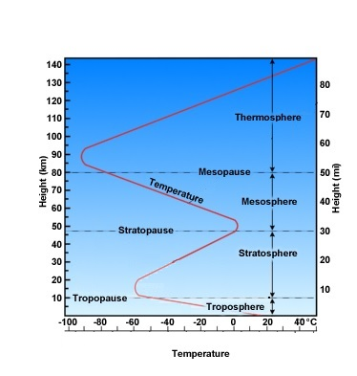
Earth’s atmosphere
©The COMET Program
Layers based on temperature
Troposphere:
  Lowest layer, up to the tropopause (8 km at poles, 15 - 18 km at equator)
  Temperature decreases with height
  Strong mixing
Stratosphere:
  Ozone (O₃) layer
  Temperature increases

Slide 4
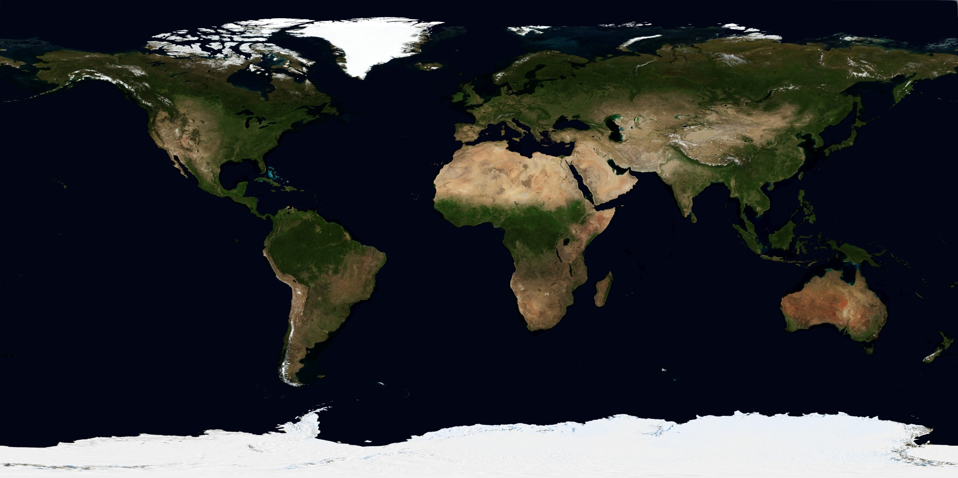
Earth’s vegetation cover
  Earth in August 2004, from images of the MODIS satellite
  (http://earthobservatory.nasa.gov/Features/BlueMarble/)

Slide 5
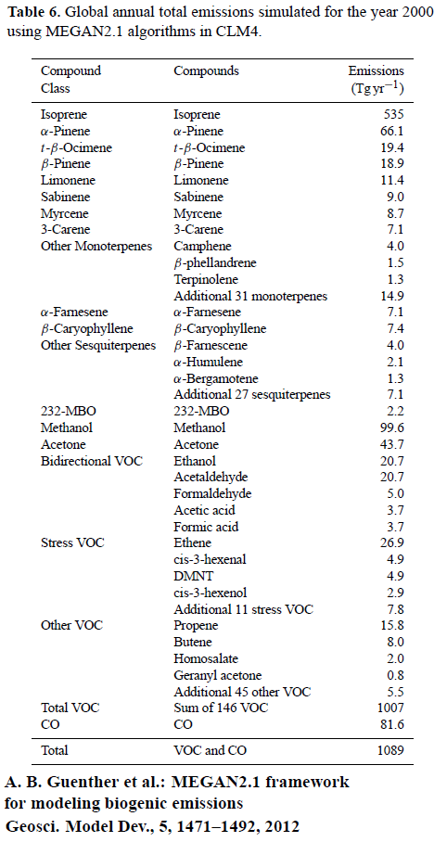
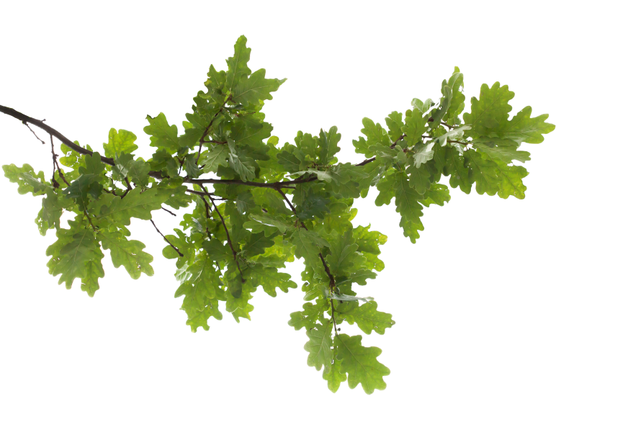
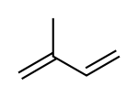
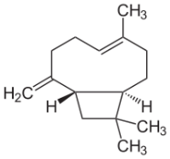
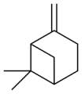
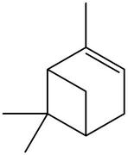
Biogenic VOC
  Isoprene (C₅)
  Monoterpenes (C₁₀)
    α-pinene
    β-pinene
  Sesquiterpenes (C₁₅)
  Total: 1000 million tonnes/year
  Anthropogenic VOC: 185 Mt/y
  (human CO₂ emissions: 36,000 Mt/y!)
500 Mt/y
70 Mt/y
20 Mt/y
7 Mt/y

Slide 6
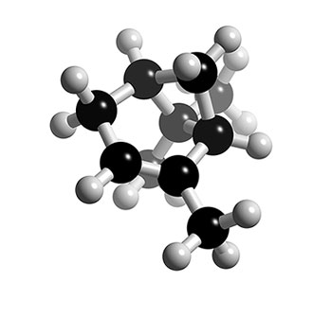
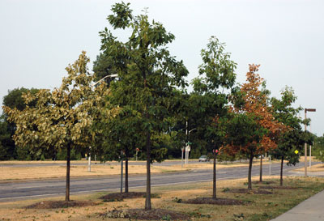
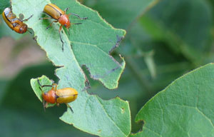
Biogenic emissions
    α-pinene
    β-pinene
  Stimulated by light and/or temperature
  Why do plants emit VOCs?
  Management of drought and heat stress
  Protection against herbivores
Source: http://msue.anr.msu.edu (Bert Cregg)

Slide 7
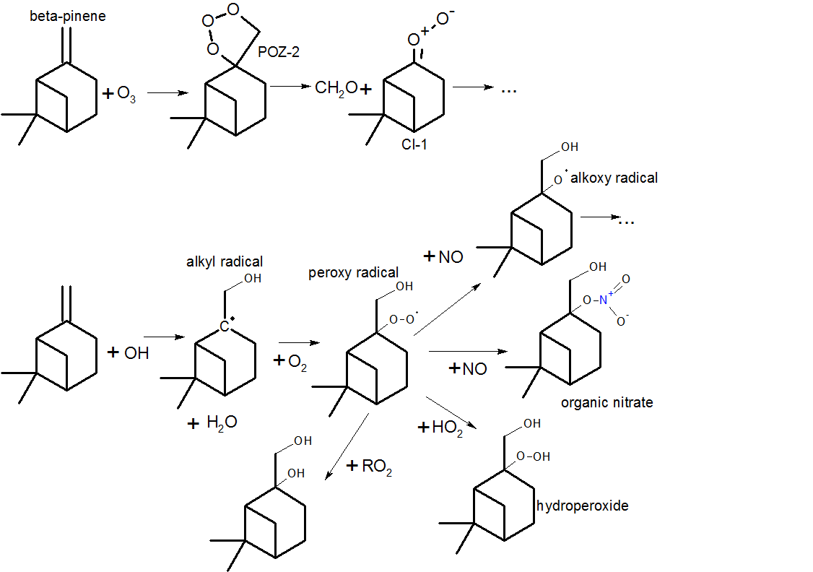


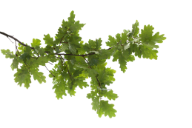

What is the fate of volatile organic compounds?
  React with ozone, OH or NO₃ radicals in air, radical chemistry:
  Some oxygenated products can condense onto aerosol particles
aerosol
condensation

Slide 8
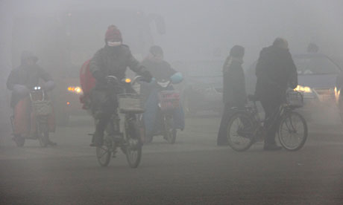
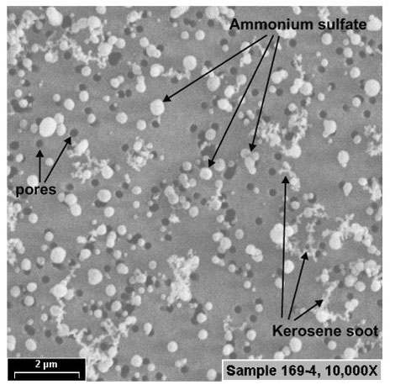
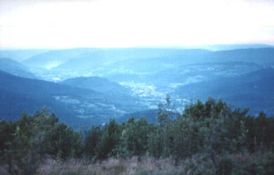
Aerosols
Source: Photograph: HAP/Quirky China News / Rex Feat
Source:http://math.ucr.edu/home/baez/physics/General/BlueSky/blue_sky.html
Source: Sheridan et al. 2005
Suspensions of microscopic particles in the air

Slide 9
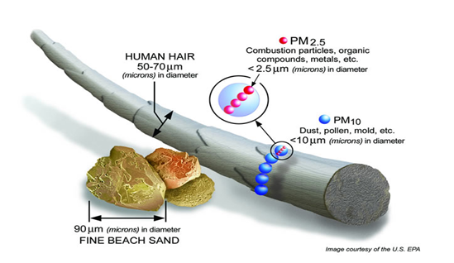
Aerosols sizes
Size varies between
1 nm to 0.01 mm
Can be inhaled
and harmful to health
3 million deaths per
year (WHO)
9

Slide 10
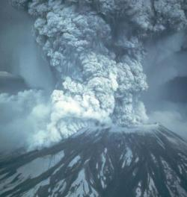
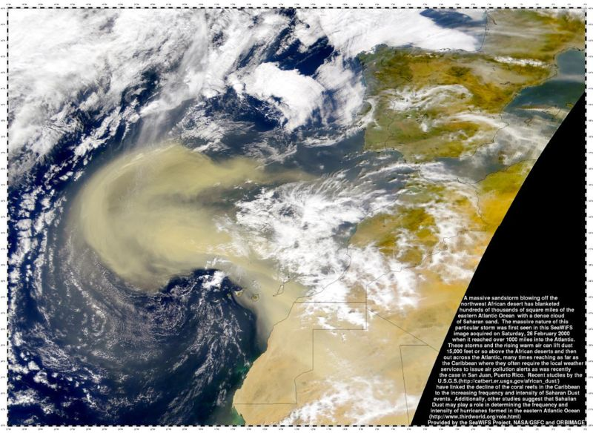
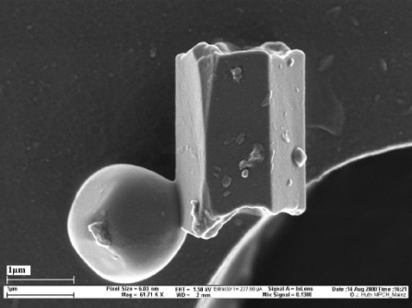
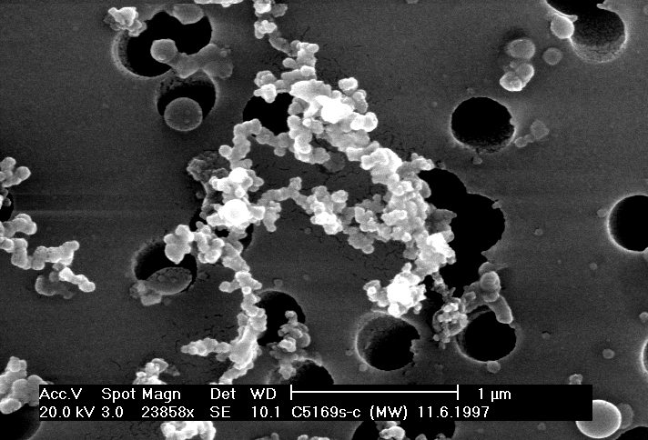
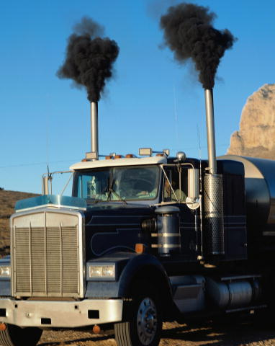
Types of aerosols:
Mineral aerosols
Dust storm above the Sahara
  Dust, volcanoes
Soot
From combustion of
fossil fuels or wood
Soot seen through electron microscope
(source: Müller & Zeitler (2005) Microsc. Microanal.)
10

Slide 11
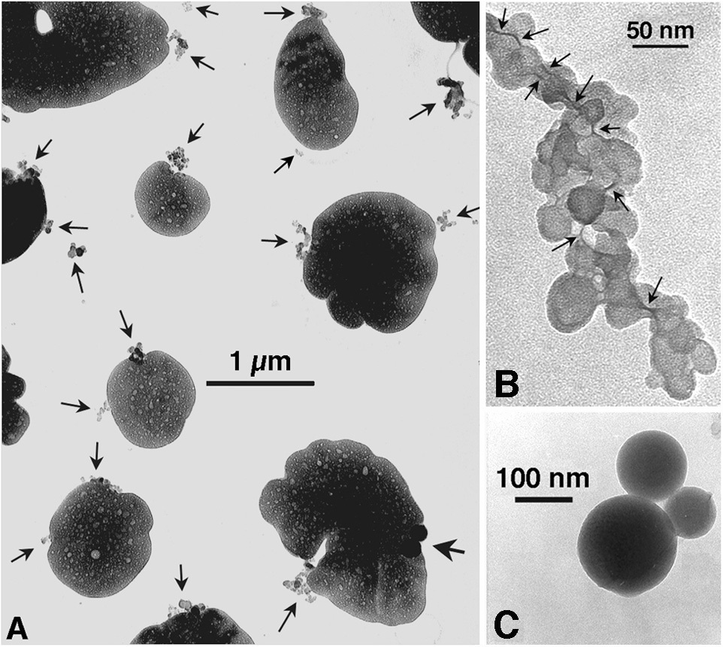
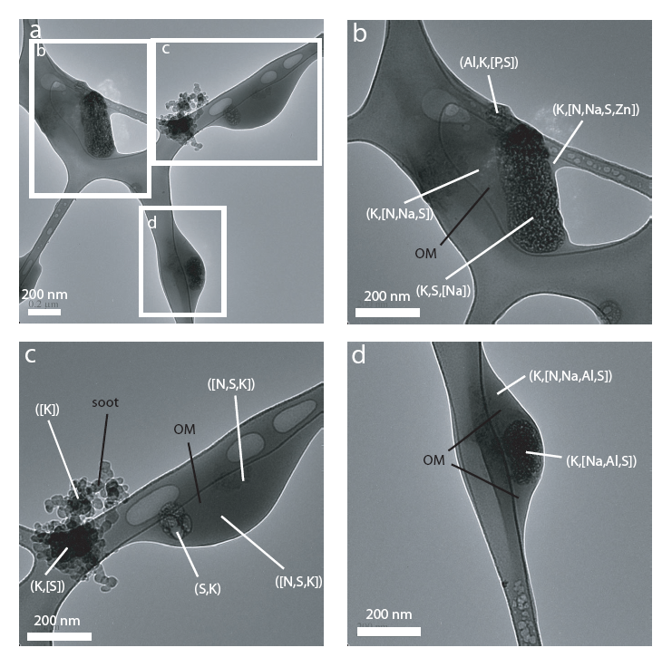
Types of aerosols:
Secondary aerosols
Left: Source: Posfai et al. (1999).
Formed by condensation of gases
Inorganic (no carbon):
Sulfate, nitrate aerosol
Organic: from oxidation of biogenic or anthropogenic VOCs
Source: Adachi
and Buseck (2008).
11

Slide 12
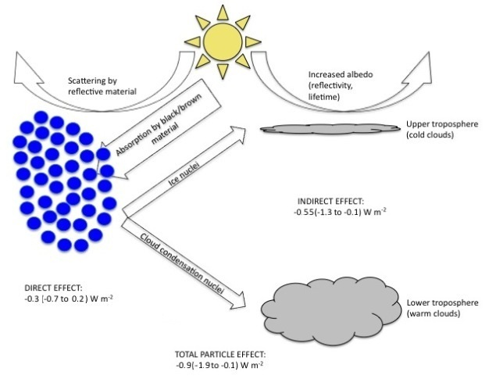

Influence of aerosols on climate: cooling effect
Direct effect: aerosols reflect light
Indirect effect: more and whiter clouds, because aerosols stimulate droplet formation
Source: R.J. Griffin, The sources and impacts of tropospheric particulate matter, Nature Education Knowledge, 4, 1, 2013.
12

Slide 13
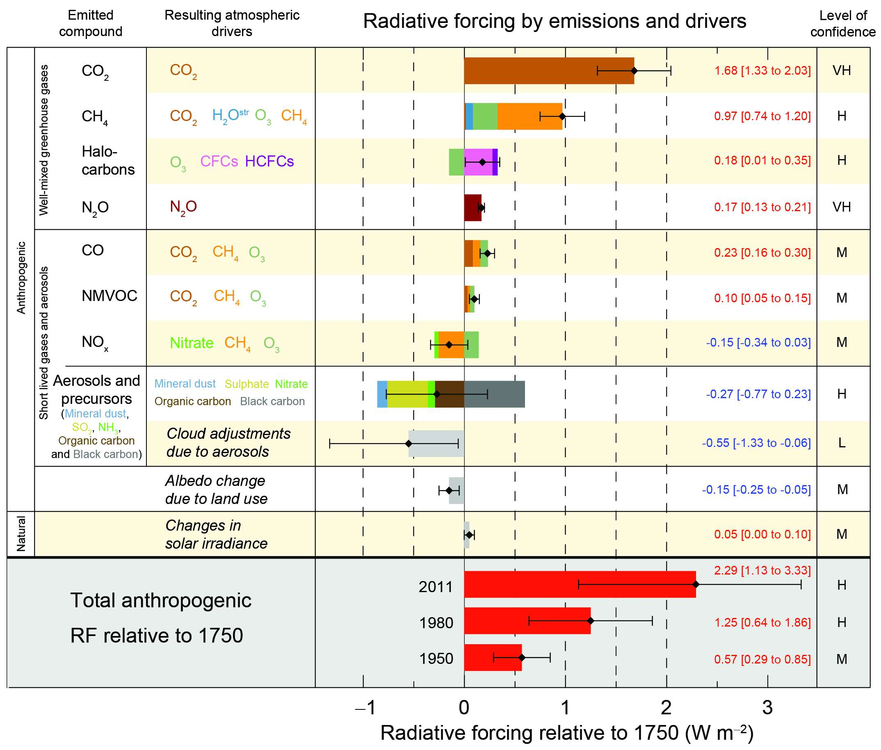
Radiative forcing on climate
Global warming caused by greenhouse gases CO_{2,} CH_{4,} N₂O
Net effect of aerosols
is cooling
But impact of aerosols on climate is more uncertain
  Large uncertainty
  for climate model predictions
More research on aerosols needed!
Source: IPCC 2013
13

Slide 14
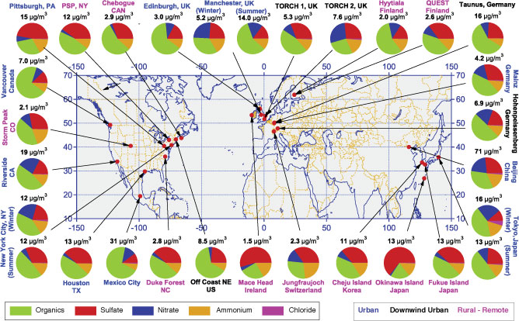
Ambient measurements of contribution of organic aerosols
Source : Zhang et al. (2007) Geoph. Res. Letters
14

Slide 15
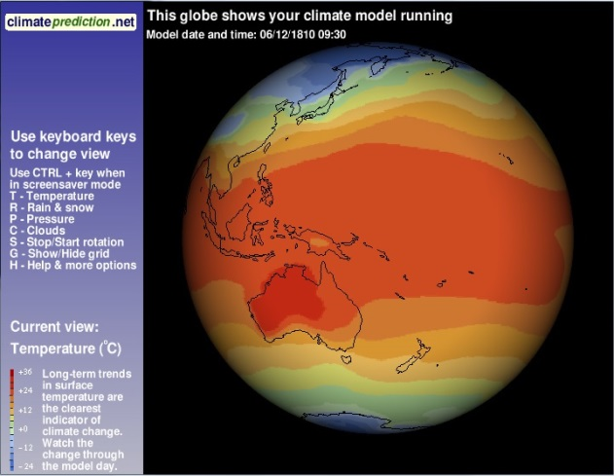
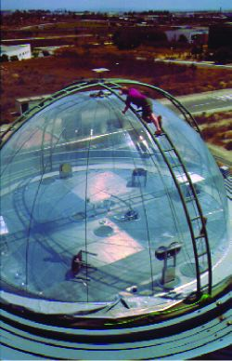
How can we investigate SOA formation?
EUPHORE smog
chamber in Valencia
Source: http://www-personal.umich.edu/~twalling/ac.html
Two compatible approaches:
Smog chamber experiments under
controlled conditions
Modelling of VOC oxidation and aerosol
formation
A model is a simplified, mathematical
representation of complex physical
processes, allowing computer simulation
We designed and tested a model for
α- and β-pinene SOA at BIRA-IASB: BOREAM
(Biogenic hydrocarbon Oxidation and
RElated Aerosol formation Model)
15

Slide 16
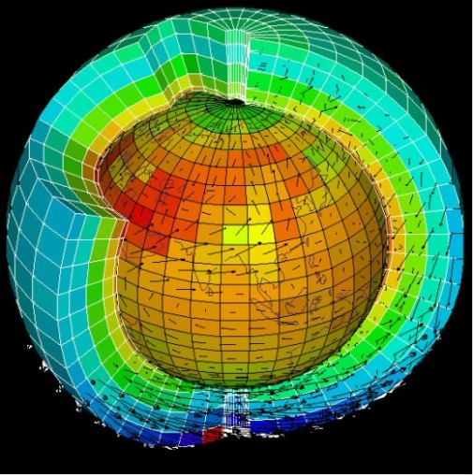
Advantages and limitations of models
Models for aerosol formation might improve
simulation of climate change and air quality
BUT
Myriads of chemical compounds and reactions
involved, also physical processes
but in most cases: very limited experimental data!
SO
Model development should be guided/controlled by an existing body of experimental results in smog chambers

Slide 17
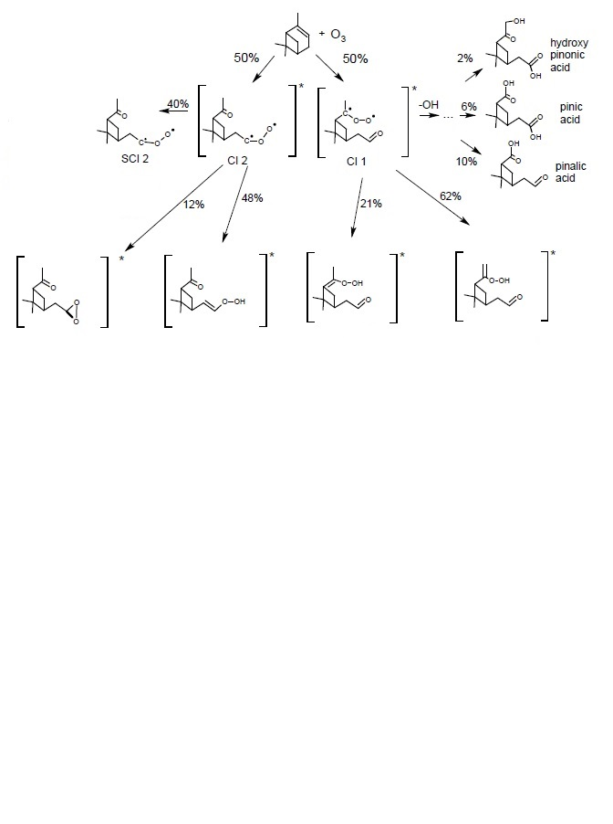
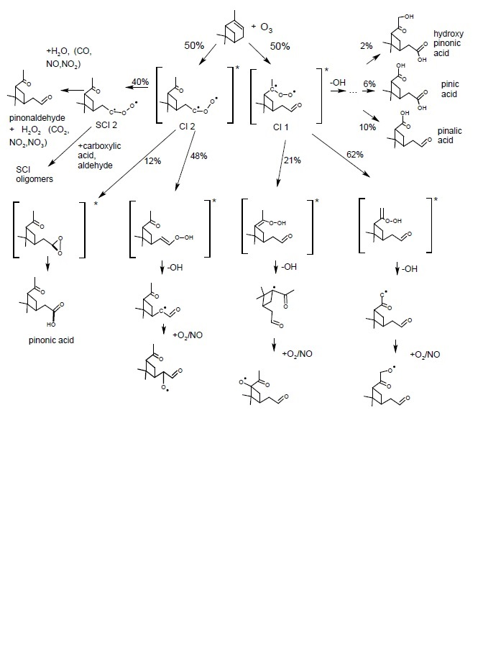
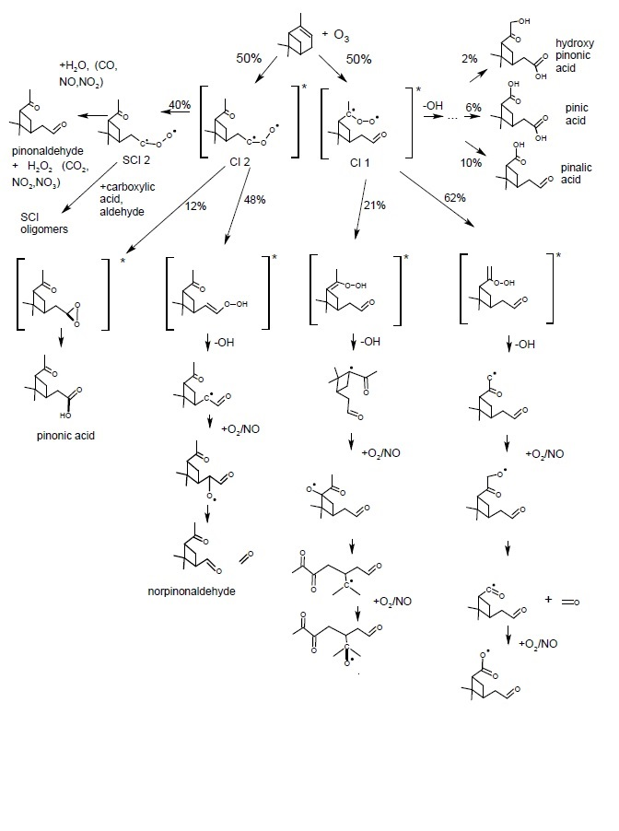
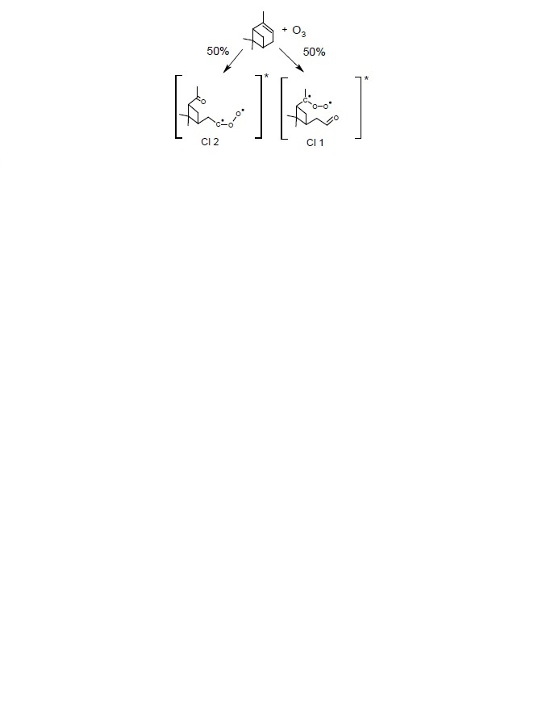
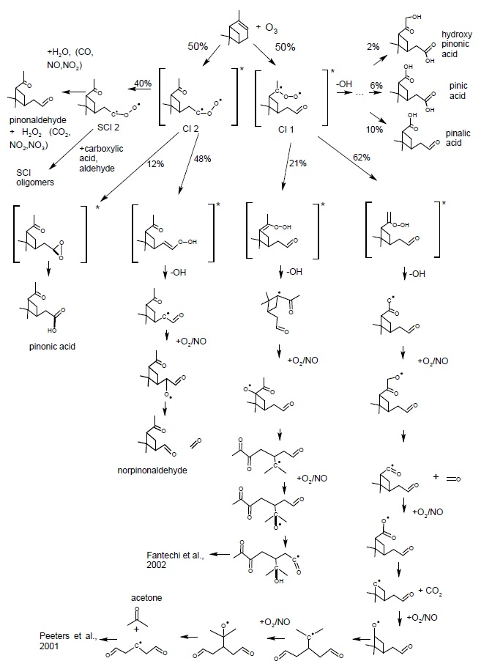
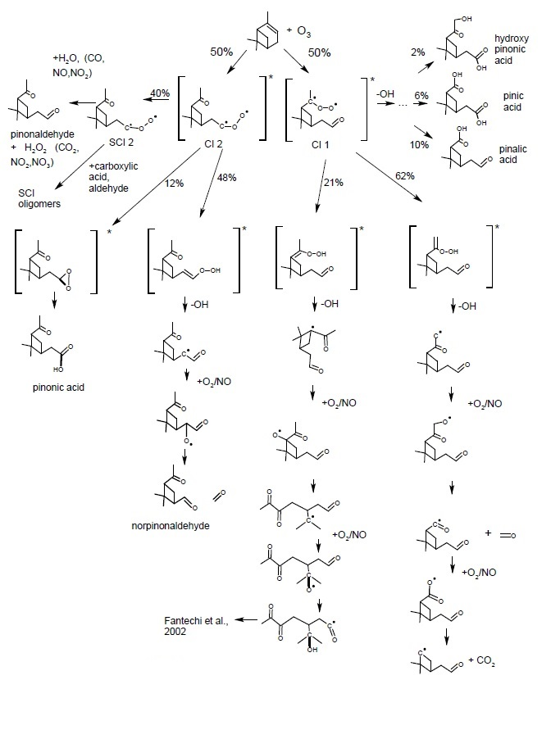
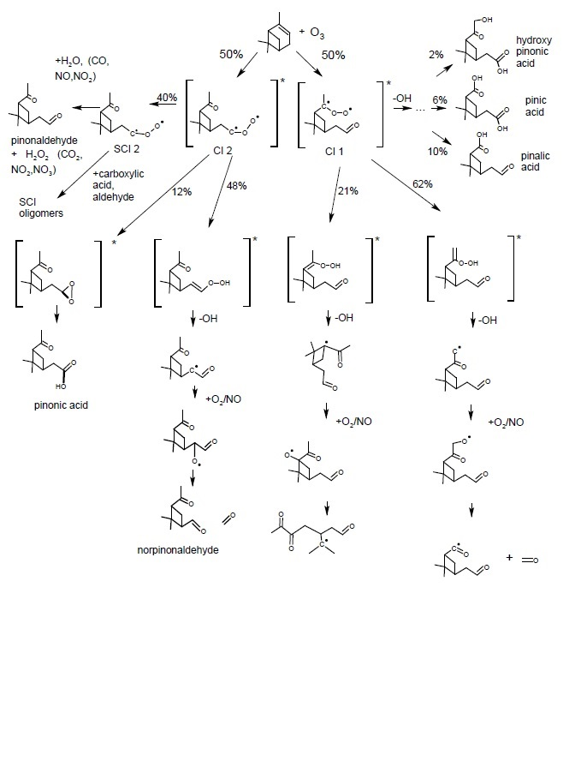
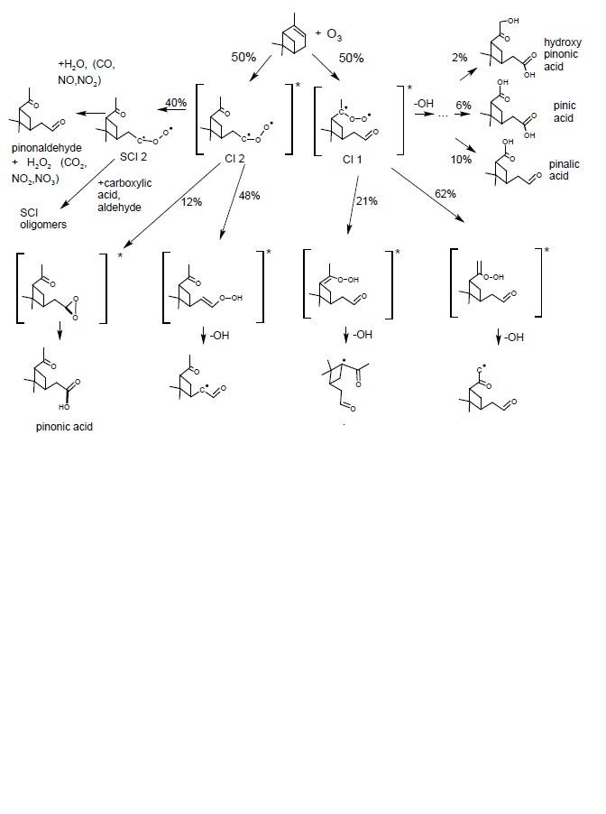
BOREAM model: primary gas phase chemistry
Ozonolysis of α-pinene: leads to 2 Criegee-intermediates
Further chemistry: no direct experimental rate determinations
Based on theoretical calculations
(Capouet et al., 2008)
Contains a large number of fast radical reactions
Leads to stable molecules, which react with OH or photolyse

Slide 18
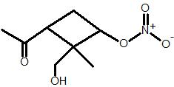


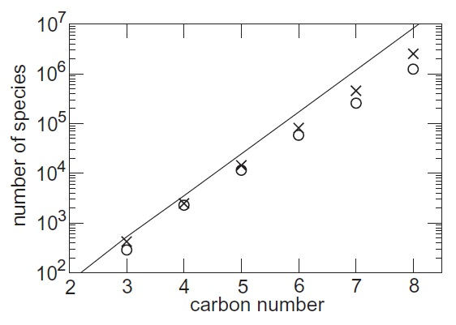
Aerosol model: secondary chemistry
1000s of products, each can react, form new products, etc.
Structure activity relationships (SARs) to predict what happens in absence of experimental data:
Automatic generation (GECKO-A model, Aumont et al. 2005)
Complete description: would require millions of species!
+ OH
Aumont et al. (2005):
number of species in
mechanisms
generated for n-alkanes

Slide 19
Aerosol model: Generic chemistry
To limit number of species in BOREAM.
We “lump” less important species with similar structures (same vapour pressure and one similar group)
Treat them as one “generic” compound in the model
Defined by carbon number, vapour pressure and one explicit functional group
We check which secondary reactions are important in current version. For these reactions, products are treated explicitly
BOREAM model: ~10,000 compounds and ~90,000 reactions
Volatility (corresponding to saturated vapour pressure p_{vap,im}) of remaining part
estimated
LX9cONO2

Slide 20
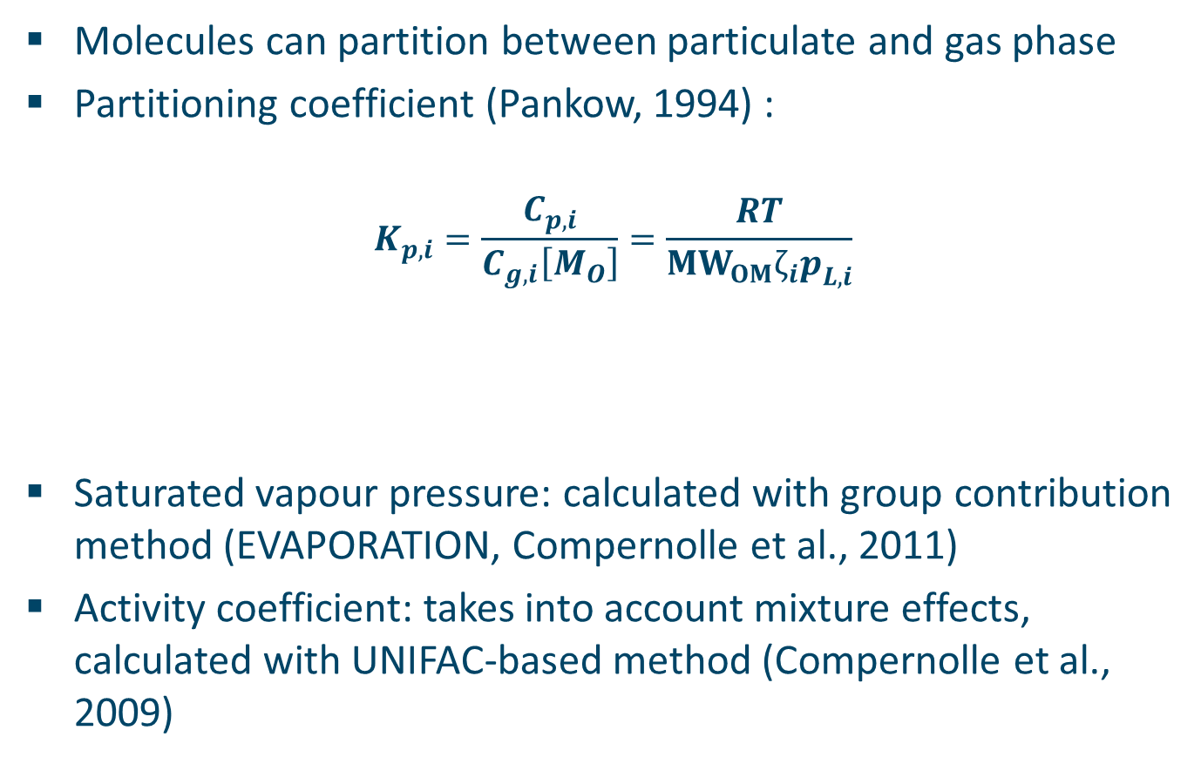
Modelling of gas/particle partitioning
Molecules can partition between particulate and gas phase
Partitioning coefficient (Pankow, 1994) :
$$K_{p,i}=\frac{C_{p,i}}{C_{g,i}\left[M_{O}\right]}=\frac{RT}{{MW}_{OM}ζ_{i}p_{L,i}^{}}$$
Saturated vapour pressure: calculated with group contribution method (EVAPORATION, Compernolle et al., 2011)
Activity coefficient: takes into account mixture effects, calculated with UNIFAC-based method (Compernolle et al., 2009)
Saturated vapour
pressure
Total absorbing
organic aerosol mass
Molecular weight
organic matter
Activity coefficient
20

Slide 21
Some earlier detailed model studies: underestimates
Modelling studies based on the Master Chemical Mechanism, (MCM) (Jenkin, 2004, Xia et al., 2008):
Find some large model underestimates (up to factor of 1000 compared to the experiment) of SOA yields
Reasons:
Inadequate vapour pressure estimation
  Incomplete secondary chemistry, missing condensable products

Slide 22
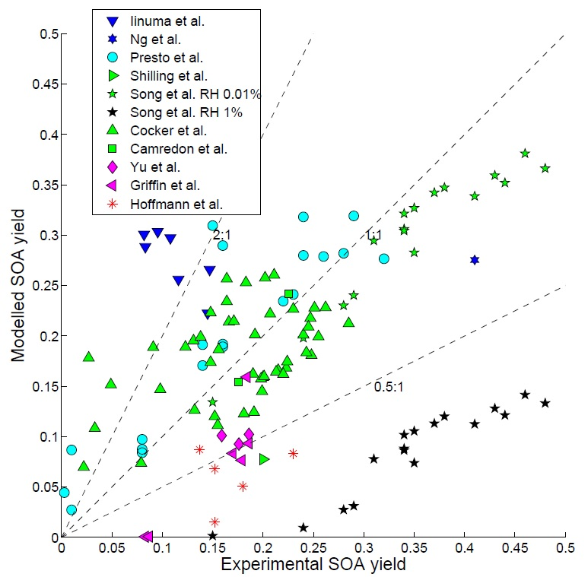
BOREAM model: α-pinene dark ozonolysis
Comparison of modelled vs. experimental yield
Majority of yields is modelled within factor of 2
Most overestimates at lower temperatures
Most underestimates
above 30 °C
Song et al.: Oligomerisation reactions can improve model agreement

Slide 23
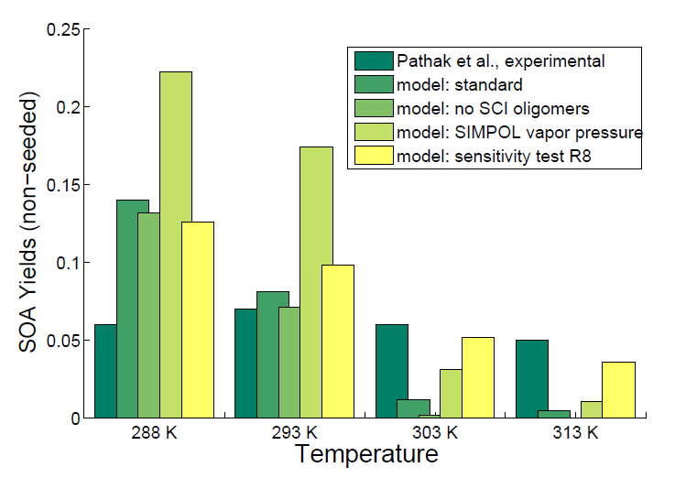
BOREAM model: α-pinene dark ozonolysis
Pathak et al. 2007 Yields
at 15, 20, 30 and 40 °C
Again:
Experimental: only minor decrease with temperature
Model: strong decrease with temperature
In yellow: adding 2.5% of completely condensable product + reduced temp. dependence p_{vap}
leads to better agreement

Slide 24
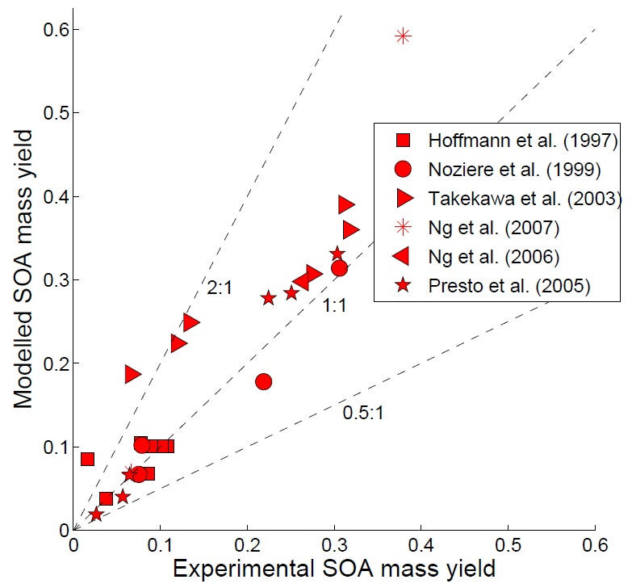
BOREAM model: α-pinene photo-oxidation
α-pinene oxidised by OH from OH-source (e.g. NO_{x}, H₂O₂ + light)
Most SOA yields modelled within a factor 2

Slide 25
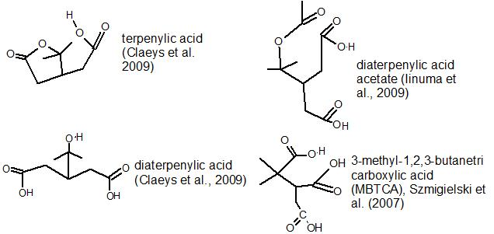
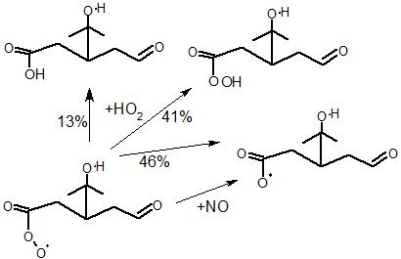
α-pinene SOA composition: gap between experiment and model
Experiment
Main identified tracers: carboxylic acids
Terpenylic acid: 1-3%, MBTCA: 1-5% SOA
(Kristensen et al., 2014)
Model
BOREAM model finds negligible yields for these carboxylic acids
One reason: low yield of carboxylic acids in bimolecular reactions of acyl peroxys

Slide 26
α-pinene SOA composition: gap between experiment and model
Experiment
In SOA: almost no hydroperoxide or peroxy acyl nitrate (PAN) species identified
Difficulties of current analysis techniques identifying these less stable compounds
Models
Models predict hydroperoxides to be major SOA species in low NO_{x}
Example: major compounds BOREAM simulations SOA for experiment E0802 in Yasmeen et al.(2012), CESAM chamber, Paris

Slide 27
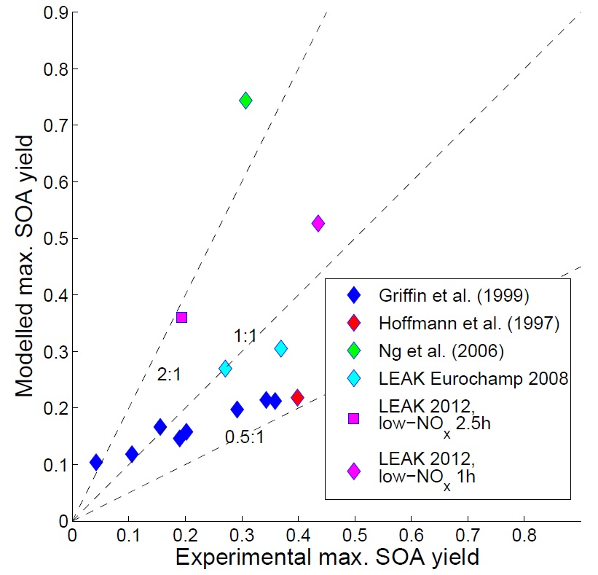
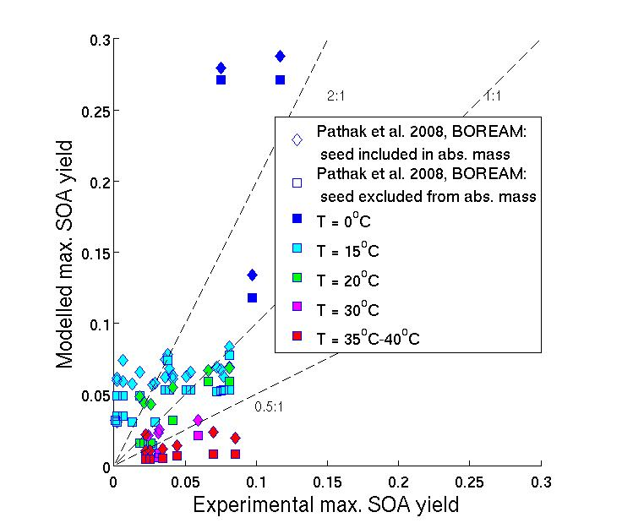
BOREAM model: β-pinene SOA
Photo-oxidation SOA
Dark ozonolysis SOA
  Same conclusions as for α-pinene

Slide 28
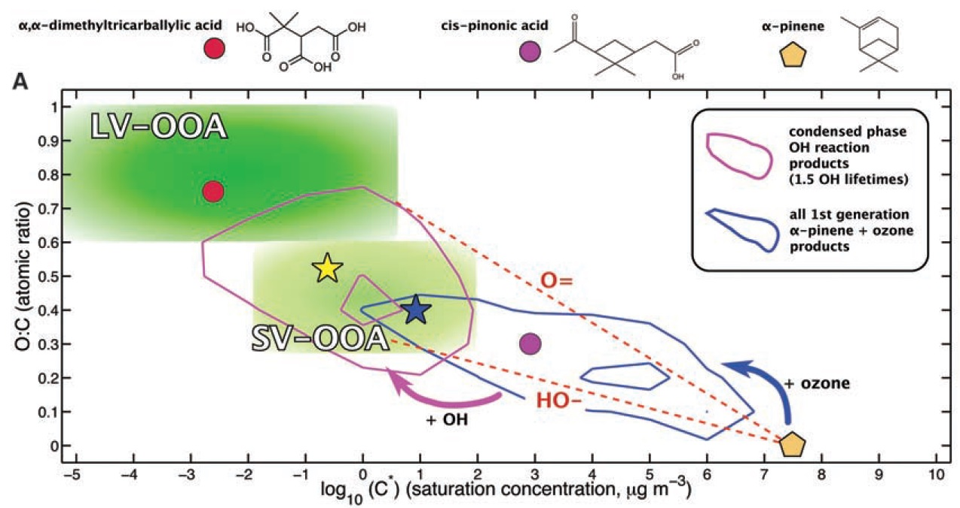
Secondary organic aerosol photooxidative ageing
Smog chamber experiments: a few hours
Average lifetime of aerosol in atmosphere: 6 to 10 days
OA in real atmosphere is more oxygenated and lower volatile than OA in most smog chamber exp.
Source: Jimenez et al.,
Science (2009)
  Long-term gas phase reaction with OH and photolysis causes this SOA ageing
  Recent chamber experiments try to achieve atmospheric ageing
  We check if the model is capable of reproducing them

Slide 29
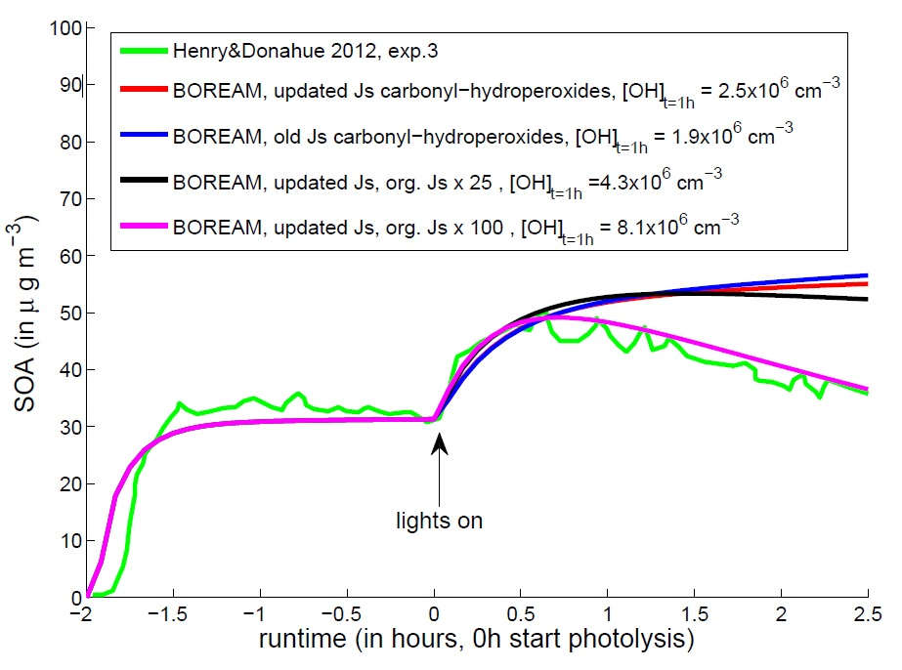
SOA photooxidative ageing experiments
Dark α-pinene ozonolysis followed by UV and OH-ageing
Exp.: Henry & Donahue, 2012,
CMU chamber, US
  First: increase, due to sudden jump in OH adding more oxyg. groups
Then: decrease in SOA, probably due to decomposition after photolysis
Model: no decrease
100x increase in j-values needed!

Slide 30


SOA photooxidative ageing experiments (2)
Dark α-pinene ozonolysis followed by UV and OH-ageing
Exp.: Tritscher et al., 2011, PSI chamber, Switzerland
The modelled SOA ageing increase is much higher than observed
Modelled O/C ratio increase (from 0.4-0.5 to 0.65-0.75) is much higher than the observed increase

Slide 31

SOA photooxidative ageing experiments (3)
α-pinene photo-oxidation and OH-oxidation
Exp.: Ng et al., 2007, Caltech chamber, US
Valorso et al., 2011: GECKO-A model
low NO_{x}
intermediate NO_{x}
high NO_{x}
BOREAM overestimates final M_{O} by between 50 and 100% (at both low, intermediate, and high NO_{x})
GECKO-A model simulates an even higher SOA concentration

Slide 32








SOA ageing experiments: wall losses
model SOA is overestimated, often by around a factor 2
Possible cause: Wall losses underestimated in experiments (Matsunaga & Ziemann, 2010; Donahue et al., 2012);
Normally: gases condense to aerosol until equilibrium
But: gases and particles are deposited on walls
Only particles in air are seen, leading to underestimation of the true aerosol amount!

Slide 33
Causes SOA ageing overestimation
Other Possible causes:
No radical chemistry in aerosol phase after aerosol phase photolysis
  Recently: some SOAs become viscous (glassy), prohibiting efficient partitioning
  Accumulation of uncertainties on kinetic rates

Slide 34


SOA ageing parametrisation
BOREAM (90,000 reactions) too large for global models
Goal: reduce #reactions, but keep similar aerosol yields
2-product model (Odum et al., 1996)
  Contains 2 products, whose yields $α_{i}$ and aerosol partitioning equilibrium constants $K_{i}$
  $α_{i}$and $K_{i}$ are chosen (fitted) to match observed aerosol mass concentrations $M_{O}$ and Yields $Y$

Slide 35


SOA ageing 10-product model
Our approach:
  Simulations of long-term ageing (12 days) reaching an equilibrium SOA, with α-pinene emissions, SOA formation and deposition
  Account for dependence on NO_{x} and oxidant (5 scenarios, two products for each), and temperature

Slide 36


Parameterisation performance
Reproduces well full BOREAM model under atmospheric conditions from global model IMAGES at 17 locations over 5 months

Slide 37


Application in global model
The parameterisation was applied for monoterpene SOA in the global chemistry transport model IMAGES (in Tsigaridis et al., 2014, Stavrakou et al., 2013)
Comparison with ambient OA concentration over US (in Stavrakou et al., 2013):
Global yearly averaged
organic aerosol
concentration as
simulated by IMAGES

Slide 38
Conclusions
  BOREAM generated based on SARs and quantum calculations
  Majority of SOA yields modelled within factor 2, but
    Dark ozonolysis: T-dependence too high
    Important observed species not formed in model – most model species remain unidentified in experiments
  New β-pinene mechanism: reasonable SOA agreement
  SOA ageing: frequent overestimates of factor 2 or more
  Parameterisation: for aged SOA, sensitive to T, NO_{x} and oxidant type; good agreement with full model

Slide 39


Acknowledgements:
  Promoters:
  Dr. Jean-François Müller (BIRA-IASB)
  Prof. dr. Magda Claeys (UAntwerpen)
  Jury:
  Prof. dr. Annemie Bogaerts (UAntwerpen)
  Prof. dr. Piet Van Espen (UAntwerpen)
  Prof. dr. Jean-François Doussin (LISA - UPEC)
  Prof. dr. Bernard Aumont (LISA - UPEC)
  I want to acknowledge the contributions, and great amount of help and advice which I received from many other scientists and colleagues:
  Dr. Steven Compernolle (BIRA-IASB), Prof. dr. Jozef Peeters (KU Leuven), Dr. Luc Vereecken (MPI Mainz), Dr. Thanh Lahm Nguyen (University of Texas), Dr. Ariane Kahnt (UAntwerpen), Dr. Jenny Stavrakou, Dr. Maite Bauwens, and the many other former colleagues at the Belgian Institute for Space Aeronomy (BIRA-IASB)
  This work would not have been possible without the
  support of the Belgian Science Policy Office (Belspo)
    Cover image: Matthias Wassermann

Slide 40


Slide 41
Additional slides

Slide 42
Composition of Earth’s atmosphere
Mostly nitrogen, oxygen, argon
Others
  Water vapour (0-4%)
  Trace gases: low concentrations: parts per million (ppm), billion (ppb)
BUT
  Some absorb light
  Some very reactive

Slide 43





Trace gases: Greenhouse gases
  CO₂ (400 ppmv)
  Methane (1800 ppbv)
  N₂O (324 ppbv)
  Greenhouse gases absorb infrared
  prevent part of heat radiation to escape to space
  rise in average temperature

Slide 44








Trace gases: volatile organic compounds (VOC)
  Anthropogenic VOC emissions
    through human activities: traffic, industry, fuel combustion, biomass burning
    185 million tonnes per year (about 25 kg per human)
    Alkanes, alkenes, aromatics, alcohols, ketones, …, …

Slide 45

α-pinene oxidation by OH

Slide 46





β-pinene OH oxidation: primary chemistry
Based on quantum-chemical calculations Vereecken & Peeters (2012)
Previously in MCM: reacts with O₂
In new mechanism: ring-opening (70% - was only 8% in MCM) , leading to complex radical chemistry

Slide 47

β-pinene O₃ oxidation: primary chemistry
Based on quantum-chemical calculations Nguyen et al.(2009)

Slide 48






BOREAM: β-pinene photo-oxidation
Gas phase: ozone production
ETC434 of Carter (2000)
Carter (2000), β-pinene + NOx + UV-lamps ( )
MCM-model study Pinho et al. (2007):
slight underestimate or good agreement O₃ ( )
BOREAM standard ( ): overestimates
(1st and 2nd), underestimate (3rd)
Tests with ring opening fraction
  8% instead of 70% (as in MCM!):
  O₃ far too high ( )
Current uncertainties prevent very accurate modelling of ozone formation
ETC435 of Carter (2000)
ETC442 of Carter (2000)

Slide 49


BOREAM: β-pinene photo-oxidation
SOA: β-pinene oxidation in high-NO_{x} and low NO_{x}
Hoffmann et al.(1997), β-pinene+NO_{x} + sunlight
Leipzig Aerosol Chamber, β-pinene + H₂O₂ + UV-lamps, low NO_{x}
BOREAM standard ( ):
  good agreement high NO_{x}
  slight overestimation low NO_{x}
tests ring opening fraction
  50% instead of 70% ( )
  slightly lower SOA
  8% instead of 70% (as in MCM!):
  far lower SOA( or )

